Slide 1
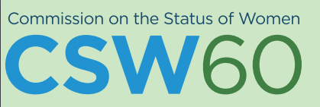

PHILIPPINE IMPLEMENTATION
ON THE AGREED CONCLUSIONS
OF THE
Director MARYANNE E.R. DARAUAY
National Economic and Development Authority
Republic of the Philippines
63rd Session of the Commission
on the Status of Women
13-14 March 2019
New York
Notes:
[Acknowledgement of Officials & Guests]
At the onset, please allow me thank the organizers of this event for providing the Philippines an opportunity to share its current initiatives and progress in its implementation of the 2030 Agenda for Sustainable Development and the Agreed Conclusions of the 60th Session of the UN Commission on the Status of Women.

Slide 2
Outline
60TH Session of the Commission on the Status of Women (CSW 60) and the Sustainable Development Goals (SDGs)
Philippine Implementation of the SDGs
Philippine Implementation of the Agreed Conclusions of the CSW60
Notes:
The outline of my presentation is as follows:
First, I will be providing you a brief background on the 60th Session of the UN Commission on the Status of Women (UNCSW 60) and how it relates to the Sustainable Development Goals (SDGs).
Second, on how the Philippines is implementing the SDGs through integration in the national and sub-national planning processes;
And lastly, I will be providing you updates on how the Philippines is implementing the Agreed Conclusions of UNCSW 60 at the national and sub-national levels.

Slide 3
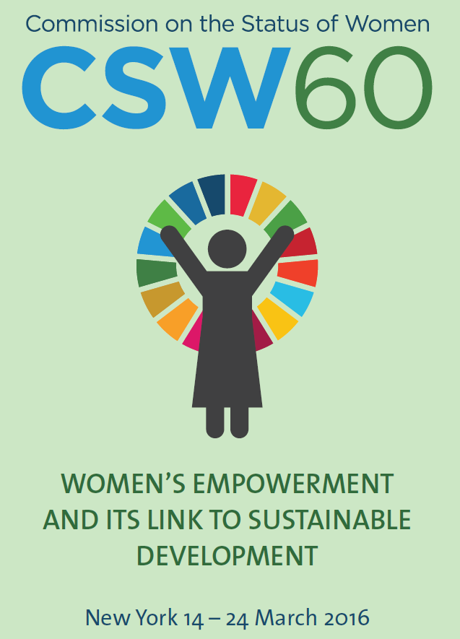
CSW60 and the SDGs
60th Session of the Commission on the Status of Women (CSW 60)
Priority theme: “Women’s empowerment and its link to sustainable development”
Detailed roadmap on how to implement the 2030 Agenda for Sustainable Development in a gender-responsive manner
Women’s equal economic rights, economic empowerment and independence are essential to the achievement of the SDGs.
Addressing the issues of women and girls will serve as an accelerator and enabler in achieving all the other SDGs
Notes:
The 60th Session of the United Nations Commission on the Status of Women was held on March 14-24, 2016 in New York. Its priority theme, “Women’s empowerment and the link to sustainable development”, resulted in a historic commitment among the UN member states to the gender-responsive implementation of the 2030 Agenda for Sustainable Development.
The “agreed conclusions” are the principal outcome of the UNCSW 60 which include the detailed roadmap on how to implement the 2030 Agenda for Sustainable Development in a gender-responsive manner, so as to ensure that no one – no woman and no girl – is left behind.
Governments and other stakeholders are now called upon to implement the actions contained in the agreed conclusions to achieve gender equality, the empowerment of all women and girls and the full realization of their human rights, otherwise known as SDG 5.
It also recognizes that women empowerment is essential to the achievement of the 2030 Agenda. It underlines the importance of undertaking legislative and other reforms to realize the equal rights of women and men, as well as girls and boys where applicable.
With the commitment to “leave no one behind”, gender equality and empowerment of women and girls have been recognized as an accelerator and enabler for all the Sustainable Development Goals (SDGs). While Goal 5 may be focused only on women and girls, it is also evident that gender issues are present in all the other goals. Thus, the systematic mainstreaming of gender perspectives across all the goals is crucial.

Slide 4
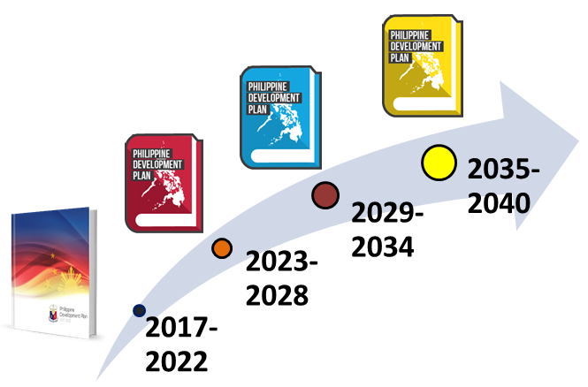


PH Implementation of the SDGs
Embedding the SDGs in our long-term vision and medium term development plans
Notes:
Now, let’s see how the Philippines is implementing the 2030 Agenda.
In the long-term, we have our 25-year vision, the AmBisyon Natin 2040, which is aligned and anchored on the SDGs.
In the medium-term, to ensure the effective implementation and timely monitoring of the SDGs, we have integrated them in the Philippine Development Plan (PDP), 2017 – 2022, in the Regional (sub-national) Development Plans (RDPs), 2017-2022, as well as in the various sectoral development plans.
The PDP ‎2017-2022 is the first medium-term development plan to operationalize Ambisyon Natin 2040—of attaining inclusive economic growth in the country and eventually transforming the Philippines into a globally competitive knowledge economy. The PDP is the blueprint of government where the priorities of the political leadership are translated into a policy and strategy framework and, then, into programs and projects. The PDP reflects all of the 17 SDGs. The integration of the SDGs in the PDP is essential as this document guides national budget appropriations (which goes through Congressional Budget Hearings). The sectoral plans are also expected to integrate the SDGs in their formulation. These include the National Plan of Action for Children, the Philippine Health Agenda, and the National Urban Development and Housing Framework, among others.

Slide 5
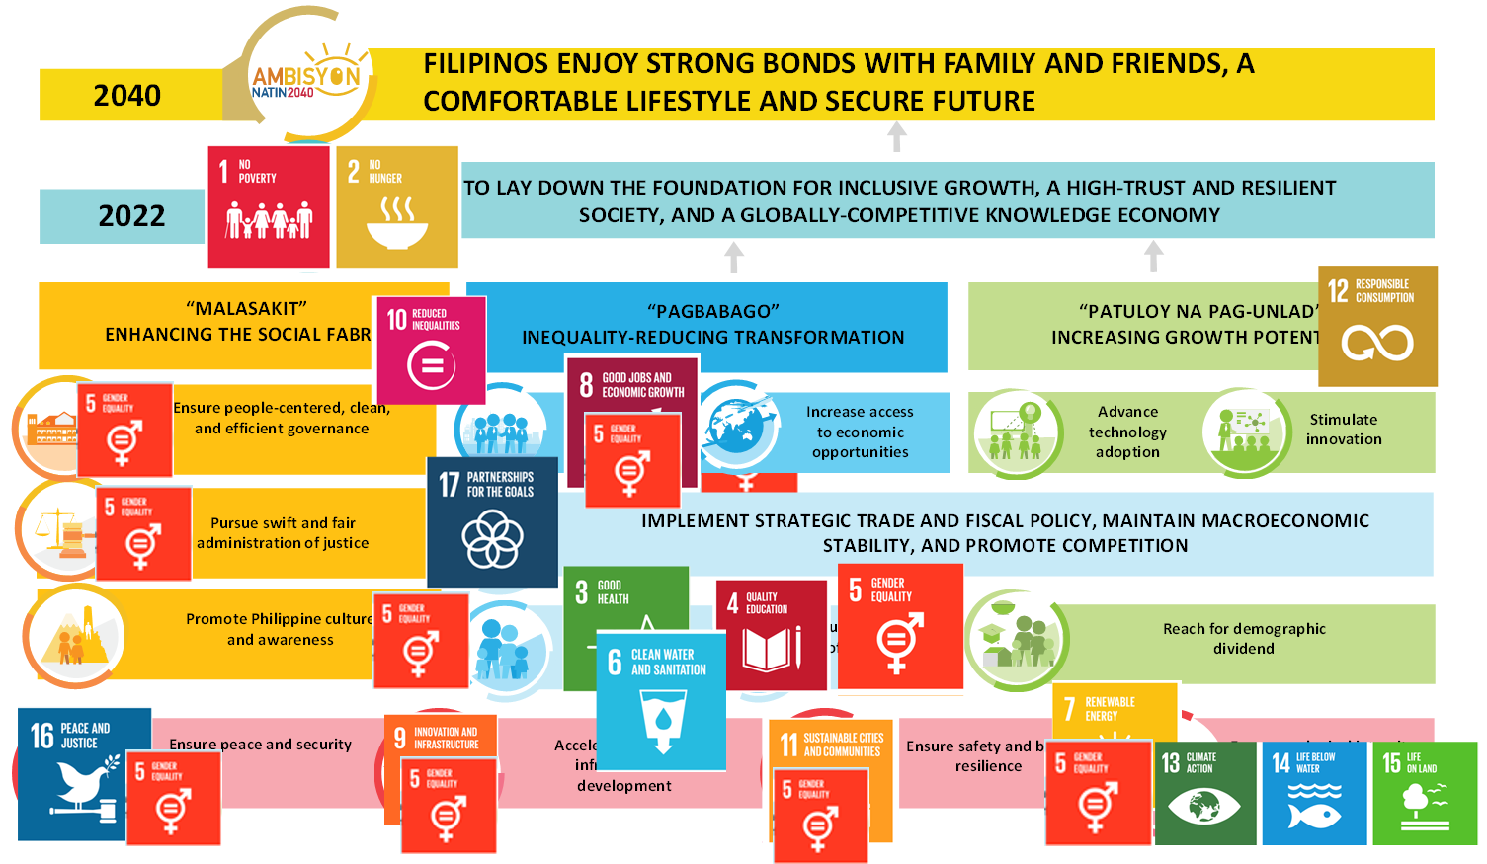
PH Implementation of the CSW60 Agreed Conclusions
The PDP, 2017-2022 and the 2030 Agenda
Notes:
This slide shows the Strategic Framework of the PDP, 2017-2022. The graphic shows how the SDGs are aligned and where you will find the gender considerations in the various chapters of the PDP.
In the PDP 2017-2022, we decided not to have a separate chapter for gender equality and women empowerment. This is to ensure that women are not isolated in the sectoral strategies and targets, and that Gender and Development (GAD) is mainstreamed in the entire planning process. Various strategies and legislative agenda have been outlined in relevant chapter of the PDP to promote gender equality and women empowerment.
To name a few:
Adopt a culture-sensitive perspective, gender-sensitive paradigm, and human rights-based approach in public service which ensures the interest of vulnerable sectors such as indigenous peoples, persons with disabilities, women, you and children (Chapter 5).
Deliver justice real-time by enhancing and expanding night courts to conduct summary hearings that require urgent action in cases involving women, children, tourists and detainees (Chapter 6).
Deliver fair and equal justice by strengthening the victim legal protection and assistance (Chapter 6).
Strengthen the protection of the rights of the vulnerable sectors, including women, to access cultural resources and live a life free from discrimination and fear (Chapter 7).
Expand the economic opportunities for those who are currently engaged in the production of agriculture, fisheries and forestry products, including women (Chapter 8)
Removal of restrictions, provision of incentives, and promotion of the development of job-creating investments which provide services to the marginalized sectors (Chapter 9).
Implementation of programs that encourage women to participate in the labor market such as: (Chapter 10)
Full implementation of the Responsible Parenthood and Reproductive Health (RPRH) Law;
Improving access and affordability of child care services;
Providing re-training services for women returning to the workforce; and
Improving access of women to entrepreneurship opportunities
Recognizing the multiple and intersecting forms of discrimination faced by women, we aim for the enactment of laws regarding the mandatory establishment of women and children-friendly spaces in all evacuation centers has been proposed. The extension of maternity leave benefits which is one of the priority legislative agenda has recently been signed into Law (RA 11210). (Chapter 11)
Adoption of a gender-responsive community-driven development approach in shelter provision towards safe and secure communities is one of the identified strategies (Chapter 12).
Address the unmet demand for family planning and unwanted pregnancies through the (1) full and aggressive implementation of RA 10354 and RA 9710, Presidential Decree 79, series of 1972 and other relevant national interventions that promote the reproductive rights of all Filipinos (Chapter 13)
(Notes:
RA 10354 – Responsible Parenthood and Reproductive Health Act of 2012
RA 9710 – Magna Carta of Women
Presidential Decree 79, series of 1972 – Revising the Population Act of 1971)
Continuously implement the United Nations Security Council Resolution 1325 and the National Action Plan on Women, Peace and Security (Chapter 17).
Enhance the capacity of the security sector to respond to gender and development issues, especially during natural and human-induced disasters (Chapter 18).
Access and other support facilities for the marginalized sectors including women, will be integrated in the design of transport infrastructure projects and gender responsiveness and accessibility will be considered in housing designs (Chapter 19).
And lastly, recognizing that efforts on disaster risk reduction and climate change adaptation remain inadequate. There is a need to strengthen information and education campaigns to increase adaptive capacity of communities, especially vulnerable groups such as women, children, older persons, indigenous peoples and persons with disabilities (Chapter 20).

Slide 6

PH Implementation of the CSW60 Agreed Conclusions
I. Strengthening normative, legal and policy frameworks
The Magna Carta of Women (MCW) or Republic Act (RA) No. 9710
105-Day Expanded Maternity Leave Law
(RA 11210)
Responsible Parenthood and Reproductive Health Act (RA No. 10354)
Universal Health Care Act (RA 11223)
First One Thousand (1,000) Days of Life (RA 11148)
Universal Access to Quality Tertiary Education Act or RA No. 10931
Image source: https://businesstips.ph/list-of-business-laws-in-the-philippines/
Notes:
Now, let’s look at how the Philippines has gone in terms of strengthening its normative, legal, and policy frameworks.
The first of which, and what we actually consider as the most essential foundation for the Philippines to further its thrust towards women empowerment is the Magna Carta of Women (MCW) or Republic Act No. 9710.
The MCW is a comprehensive women's human rights law enacted in 2009 that seeks to eliminate discrimination through the recognition, protection, fulfilment and promotion of the rights of Filipino women, especially those belonging in the marginalized sectors of the society. It is the local translation of the Convention on the Elimination of All Forms of Discrimination against Women's (CEDAW), particularly in defining gender discrimination, state obligations, substantive equality, and temporary special measures. It also recognizes human rights guaranteed by the international Covenant on Economic, Social and Cultural Rights (ICESCR). Through its provisions, the MCW levels up the playing field by making productive resources and economic opportunities equally available for both men and women.
The Expanded Maternity Act was recently signed into law in February 2019. Under the new law, the maternity leave is extended from 60 to 105 days. All working mothers in the government and private sector are guaranteed with 105 days of paid maternity leave credits, with 7 days transferable to fathers. An additional 15 days of paid leave will be granted to single mothers. It also gives mothers the option to extend their leave for another 30 days without pay, provided that the employer is given due notice in writing at least 45 days ahead before the end of the maternity leave. This new law puts the Philippines at par with the international standards and provides the mothers with ample time for recovery after pregnancy.
The Responsible Parenthood and Reproductive Health Act of 2012 mandates the Philippine government to comprehensively address the needs of Filipino citizens when it comes to responsible parenthood and reproductive health. It guarantees: a) access to services to RH and family planning, with due regard to informed choice and consent of the concerned parties who will avail of these services; b) maternal health services; c) information and education on RH, and d) regular funding for law's implementation.
The Universal Health Care (UHC) Act which was recently enacted in February 2019 seeks to ensure that every Filipino citizen is entitled to healthy living, working and schooling conditions and access to a comprehensive set of health services without financial hardship. It will automatically cover all Filipinos in the National Health Insurance Program of the Philippine Health Insurance Corporation (PhilHealth).
The Act Scaling Up the National and Local Health and Nutrition Programs Through a Strengthened Integrated Strategy for Maternal, Neonatal, Child Health and Nutrition in the First One Thousand (1,000) Days of Life seeks to refocus interventions for addressing malnutrition among the most nutritionally at risk, prioritizing women of reproductive age, especially adolescent girls, teen-age mothers, pregnant and lactating women and children from birth up to 24 months, to address the health and nutrition problems of these vulnerable groups. The law tasked the Department of Health, the National Nutrition Council (NNC) and its Governing Board members to formulate a strategy that is comprehensive and sustainable.
Another landmark law passed in 2017 is the Universal Access to Quality Tertiary Education Act. This law aims to promote social justice and the advancement of nation building by providing access to quality education to all Filipino students. It has four program components, namely: (1) free higher education in state universities and colleges; (2) free technical-vocational training (TVET) in state run technical-vocational institutions (TVIs); (3) tertiary education subsidy (for students enrolled in either public or private tertiary education institution); and (4) student loan for tertiary education. With this policy, girls/females (or especially among boys/males who usually discontinue their education to pursue work instead) can gain more access to tertiary education regardless of their socio-economic/financial status.

Slide 7
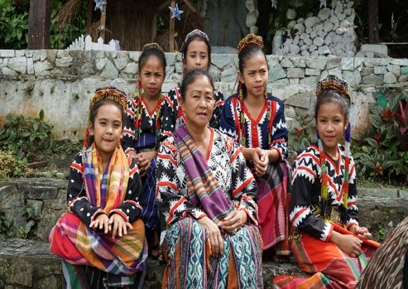
PH Implementation of the CSW60 Agreed Conclusions
I. Strengthening normative, legal and policy frameworks
Gender Equality and Women’s Empowerment (GEWE) Plan, 2019-2025
Beijing Declaration and Platform for Action (BPfA) + 25 Philippine Progress Report
Study on the Determinants of Female Labor Force Participation
Longitudinal Cohort Study on the Filipino Girl and Boy Child
Cash transfers (conditional and unconditional)
Notes:
Here are the other initiatives of the Philippines in terms of programs, policies, or studies, which directly impact the lives of Filipino women and girls.
Another important milestone for the Philippines is the crafting of the Gender Equality and Women’s Empowerment (GEWE) Plan, 2019-2025 which will serve as the key guide of all government instrumentalities in the preparation of their annual GAD plans and budgets. It is anchored on the Philippine Development Plan, 2017 to 2022 and AmBisyon Natin 2040.
The GEWE contains priority strategies for national government agencies and local government units (LGUs) to ensure that their collective efforts result in more meaningful and strategic outcomes and, taken together, will significantly contribute to the desired positive changes in the status and condition of Filipino women, particularly the poor and marginalized among them. The objectives of the GEWE also aims to fulfill the Philippine Government’s commitment as State Party to various international commitments and treaties such as to the United Nations International Covenant on Economic, Social and Cultural Rights (ICESCR) and the SDGs.
We are currently preparing the BPfA+25 Philippine Progress Report. The Country Report will highlight major achievements on gender equality and women empowerment and its contribution towards the achievement of the SDGs and the challenges in its implementation.
A study is currently being conducted by the Philippine Government on identifying the determinants of female labor force participation to better assist in female productivity improvements in terms of part-time work, telecommuting, extended maternity leave, establishment of day care facilities, among others.
Another Longitudinal Cohort Study on the Filipino Girl and Boy Child is also currently being conducted to support the implementation of the SDGs, and will focus on assessing how the profile, characteristics, behavior and decisions of the present group of Filipino adolescents will change in the next fifteen years (from 2016 to 2030). The study involves 5,000 cohort participants and the findings of the study are expected to help inform future social policy formulation and development programming. It will also help improve understanding of adolescents’ characteristics, behavior and decisions that could help in the formulation of relevant policies and programs for the age group.
The Philippine government also has various cash transfer programs targeted to various groups in the population. Once of which is the Unconditional Cash Transfer (UCT) program which is the biggest tax reform mitigation program under the TRAIN (Tax Reform Acceleration and Inclusion) Law of the Philippines. It seeks to provide cash grants to poor households and individuals who may not benefit from the lower income tax rates but may be adversely affected by rising prices.
Another is the Modified Conditional Cash Transfer (MCCT) program, which aims to contribute to the reduction of children in the streets as well as respond to the development needs of Children and Families in Need of Special Protection through the provision of cash grants for education and health needs under the umbrella program of the Pantawid Pamilyang Pilipino Program (4Ps) – the flagship CCT program of the Philippines. These programs contribute to the economic empowerment of Filipino women which in turn result to better outcomes in improving their standards of living.

Slide 8
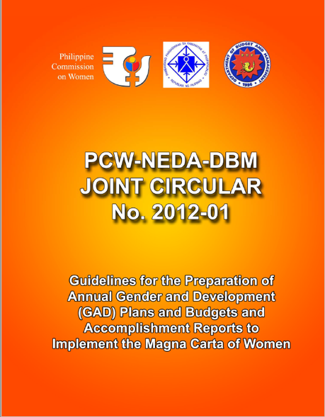


PH Implementation of the CSW60 Agreed Conclusions
II. Financing for gender equality and the empowerment of women and girls
GAD Planning and Budgeting
  All government instrumentalities formulate their annual GAD Plans and Budgets based on their mandates and gender needs of their clients as stipulated in the NEDA-PCW-DBM Joint Memorandum Circular (JMC) No. 2012-01
  Allocate at least 5% of total agency budget
Annual Audit of GAD Budget
Notes:
Another focus area of the Agreed Conclusions of the CSW 60 is to ensure adequate financing for gender equality and women empowerment.
In the Philippines, the GAD Planning and Budgeting (GPB) of government agencies serves as an important mechanism for gender mainstreaming. The Philippine Commission on Women (PCW), together with National Economic and Development Authority (NEDA and the Department of Budget and Management (DBM) issued Joint Memorandum Circular (JMC) No. 2012-01 which sets the guidelines for the preparation of annual GAD Plans and Budgets. This directs all government agencies, state universities and colleges (SUCs), government-owned and controlled corporations (GOCCs), and other government instrumentalities to formulate their annual GAD Plans and Budgets based on their mandates and gender needs of their clients.
The GAD Plan seeks to address identified women and gender issues through specific activities while the GAD Budget pertains to the amount required to implement the GAD Plan. As mandated by the MCW, each government instrumentality is directed to allocate at least 5% of total agency budget on GAD Activities. A similar policy has also been issued to guide LGUs in localizing the MCW (JMC 2013-01).
To ensure the judicious use of the GAD Budget, an annual audit is being conducted by the Commission on Audit (COA).

Slide 9
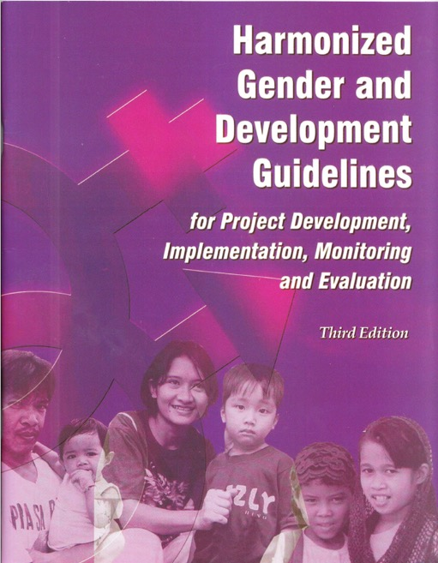
PH Implementation of the CSW60 Agreed Conclusions
II. Financing for gender equality and the empowerment of women and girls
Harmonized Gender and Development Guidelines (HGDG)
  A common instrument in integrating gender perspectives in development programs and projects
NEDA Board Investment Coordination Committee (ICC) Policy on Integrating the HGDG in the ICC Process
  the proponent agencies of major national projects are required to ensure gender-responsiveness on their proposed projects
Notes:
Another important mechanism for ensuring the integration of GAD perspective in development planning processes as well as in programming is the use of the Harmonized Gender and Development Guidelines (HGDG) in the various stages of the project cycle.
The HGDG for Project Development, Implementation, Monitoring, and Evaluation was formulated in 2004 by NEDA and PCW with funding support from the United Nations Development Programme (UNDP) and the Asian Development Bank (ADB).
It aims to provide a common instrument in integrating gender perspectives in development programs and projects not only within government agencies but also among donor organizations, development partners, and other stakeholders. This tool guides the integration of the GAD perspective in the development planning processes and various stages of the project cycle; and address the issues of inadequate sex-disaggregated data and statistics for development planning and programming. It has been in use for more than a decade now and has successfully facilitated gender mainstreaming efforts throughout the Philippines.
To strengthen further the adoption of the HGDG Guidelines, a policy was issued to respond to the call on including GAD in the evaluation criteria of programs and projects that are reviewed by the NEDA Board-Investment Coordination Committee (ICC). The ICC is in charge in the evaluation of the fiscal, monetary and balance of payments implications of major national projects, and provides recommendations to the President on the country’s domestic and foreign borrowing programs. With the adoption of the HGDG in the ICC Process, the proponent agencies are required to ensure gender-responsiveness on their proposed projects by submitting a checklist to be included in their project evaluation reports.

Slide 10
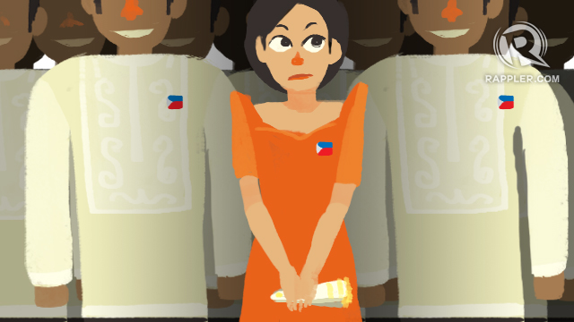
PH Implementation of the CSW60 Agreed Conclusions
III. Strengthening Women’s Leadership and Full and Equal Participation in Decision-making
Accelerating women’s political participation
  Formulation of the Guidelines on promoting women’s integration in political parties and party-list organizations
Image source: https://www.rappler.com/move-ph/124248-women-politics-governance
Occupied Third-level Positions in the Government (as of Dec. 2018)
 | No. of Positions | Percentage Share
Male | 1,074 | 57%
Female | 815 | 43%
TOTAL | 1,889 | 100%
Accelerating women’s equal participation in the civil service
Source: Career Executive Service Report (2018)
Notes:
To ensure the participation of women in all levels of development planning and program implementation, at least forty percent (40%) of membership of all development councils from the regional, provincial, city, municipal, and barangay levels shall be composed of women, as stipulated under Section 11 of MCW. It also empowers the Civil Service by increasing the number of women in third level positions in the government to achieve a fifty-fifty (50-50) gender balance. The government agencies are also required to regularly report the number of women nominees to vacant third level positions and the number of women appointees vis-à-vis men.
As of December 2018, it may be noted that 57% of the third-level government positions (namely undersecretary, assistant secretary, bureau director, regional director—the senior ranks in government), are occupied by men while 43% by women.
We aim to improve this through the continuous advocacies of the Philippine government in enhancing the institutional human resource management competencies, systems, and practices, as well as the continuous efforts on providing equitable and quality education and lifelong learning opportunities for both men and women.

Slide 11
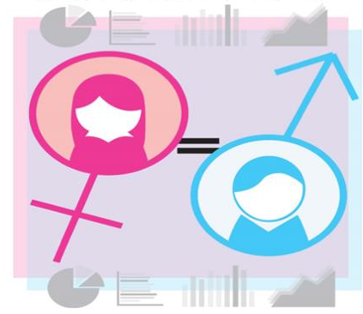
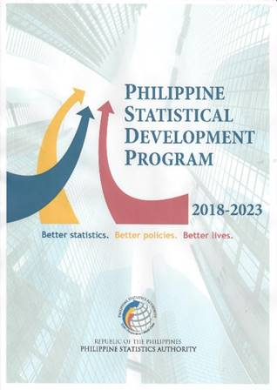
PH Implementation of the CSW60 Agreed Conclusions
IV. Strengthening Gender-responsive data collection
Interagency Committee on Gender and Children Statistics
  address the concerns on the production, dissemination, and archiving of statistics on gender and children
Chapter on Children, Gender, and Development, and SDGs in the Philippine Statistical Development Program 2018-2023
  covers statistical data and indicators used in assessing SDGs & GAD status in the country that reflects the living conditions and situation of children and women.
Image sources: Philippine Statistics Authority
Notes:
Another focus area of the CSW60 is the strengthening of data collection on Gender Statistics.
An Interagency Committee on Gender and Children Statistics (IACGCS) has been created within the National Statistical System to address the concerns on the production, dissemination, and archiving of statistics on gender and children. Emerging issues and concerns like data revolution, open data, big data, among others, and international commitments such as the SDGs on statistics on children and gender and other related indicators are being coordinated by the Committee.
Another important mechanism for the strengthening of data collection for gender statistics is the Philippine Statistical Development Program (PSDP), 2018-2023. The PSDP is the country’s mechanism for setting the directions, thrusts and priorities of the Philippine Statistical System (PSS) in the medium term for the generation and dissemination of statistical information for policy- and decision-making of the government, private sector and general public. The PSDP contains priority statistical development programs and activities designed to provide vital information support to national development planning and international commitments.
Chapters on Children & Gender, and Development and SDGs are also included in the PSDP. The Chapter on Children and Gender and Development covers statistical data and indicators used in assessing GAD status in the country that reflects the living conditions and situation of children and women. It includes the core set of GAD indicators (including SDG 5 indicators), which monitors the role and status of women and men in: education and training, economy, health, poverty, institutional mechanisms, media, power and decision-making, environment, violence against women/girl child, and armed conflict/human rights.
Meanwhile, the Chapter on SDG Monitoring provides a strategic plan for the development and improvement of statistical data and indicators that aid in the creation, implementation and monitoring of policies and programs to promote and ensure achievement of the SDGs in the country. Further, the chapter steers data support and monitoring of the 17 SDGs, 169 targets and 232 unique indicators.

Slide 12
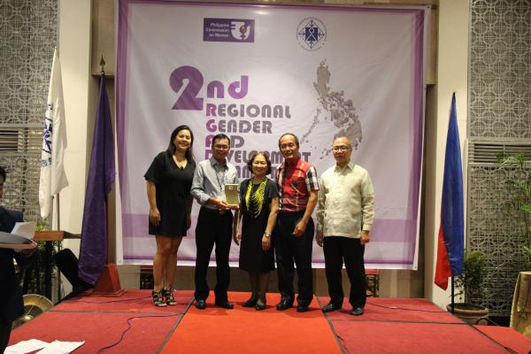
PH Implementation of the CSW60 Agreed Conclusions
V. Enhancing National Institutional Arrangements
Institutionalization of the GAD Focal Point System (GFPS)
Regional Gender and Development Committee (subnational committees within the administrative regions of the Philippines)
Localization of the Magna Carta of Women through PCW-DILG-DBM-NEDA Joint Memorandum Circular No. 2013-01
Image source: Philippine Commission on Women
Notes:
As mandated by the MCW, all government agencies and instrumentalities are required to establish or strengthen their GAD Focal Point System (GFPS). The GFPS shall lead in mainstreaming gender perspective in their agency/department policies, plans and programs. They are also tasked to ensure the assessment of the gender-responsiveness of systems, structures, policies, programs, processes, and procedures within their agency based on the priority needs and concerns of constituencies and employees and the formulation of recommendations including their implementation.
At the sub-national level, all Regions have already established their Regional Gender and Development Committees (RGADCs). These were established to initiate, coordinate and monitor gender mainstreaming a the subnational levels, strengthen stakeholder participation especially of women and sectoral groups in the preparation, implementation, and monitoring of sub-national development plans.
Another milestone for the Philippines in localizing the MCW is through the PCW-DILG-DBM-NEDA JMC No. 2013-01 which prescribes the policies and procedures in mainstreaming gender perspectives in local planning, programming and budgeting; local legislation; project development, implementation, monitoring and evaluation pursuant to the MCW. It aims to strengthen the horizontal and vertical relationships between and among the national and sub-national government units as well as align their efforts in mainstreaming GAD. This circular also directs local chief executives to ensure that their GFPS or similar GAD mechanisms are in place, fully-functional and its members have the capacity to promote gender mainstreaming.

Slide 13
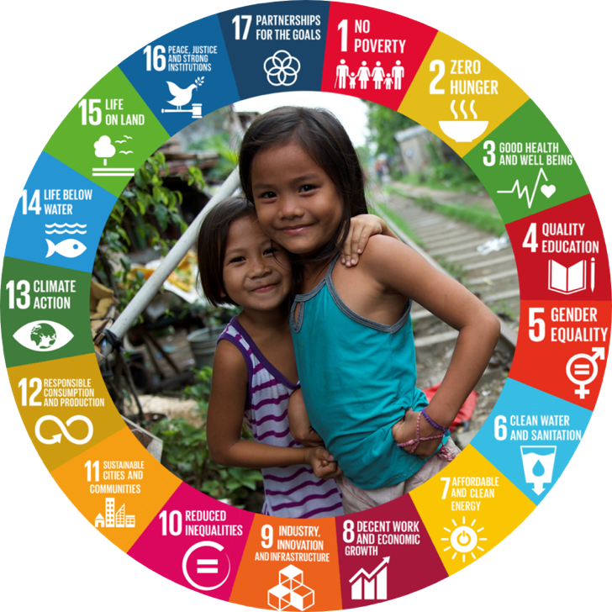
“Women’s rights is the life of every human person’s heart, blood of many men and women.”
– Sen. Leticia Shahani
Image source: UNICEF Philippines
Notes:
Let us all work together towards achieving and fulfilling the rights our women to foster a global community where no one is left behind.
Because at the end of the day, as former Philippine Senator Leticia Shahani said “How to keep the passion: Just think that behind every sentence(women’s rights) is the life of every human person’s heart, blood of many men and women.”
Thank you and mabuhay!

